Slide 1

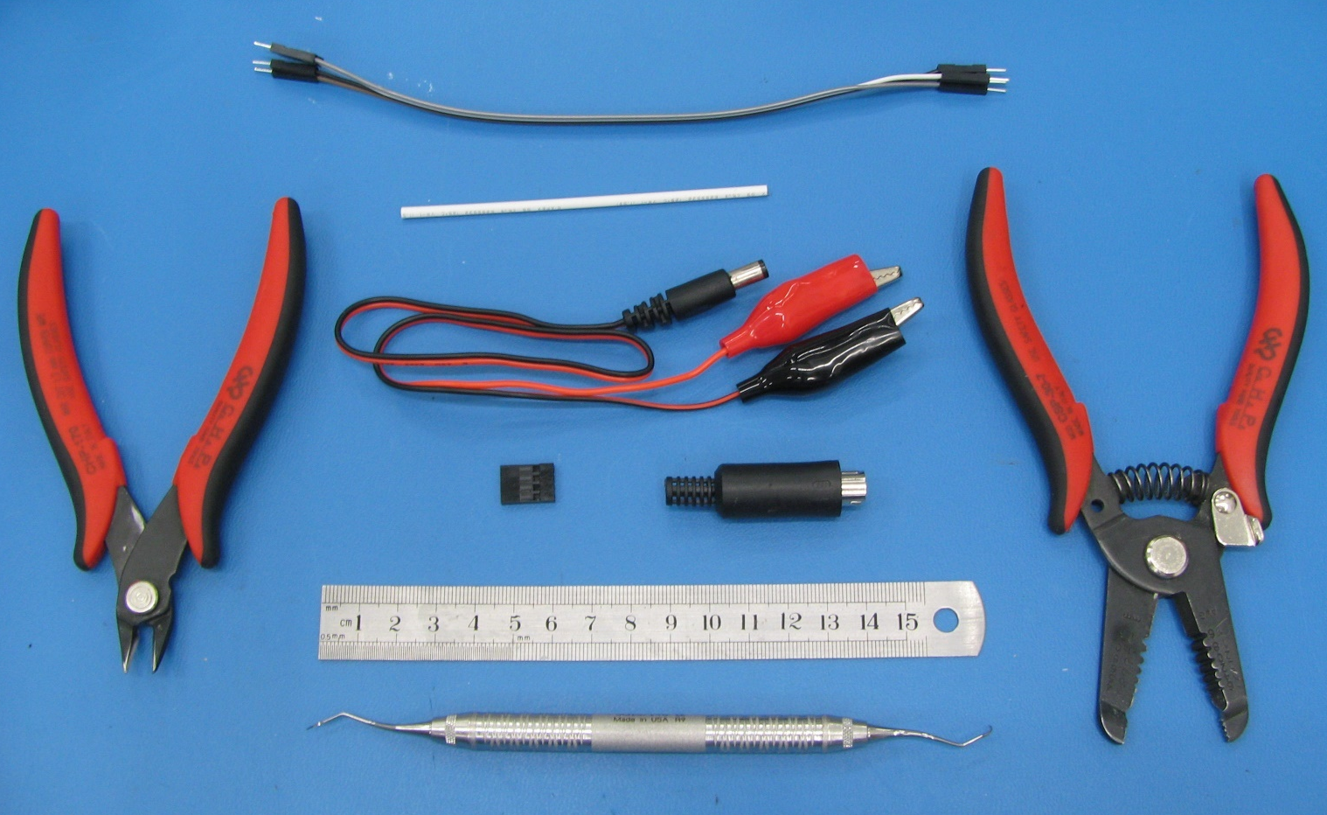
Assembly Instructions
Roomba Cable [E-46]
1
Parts & Tools
2
# | Qty | Name
1 | 1 | 4 wire Male to Male Dupont cable
2 | 1 | 1/16” Heatshrink Tubing
3 | 1 | 2.1mm Barrel Plug + Alligator Clips
4 | 1 | 0.1” Pitch 4 position Dupont header
5 | 1 | 7 pin mini DIN male connector
6 | 1 | Flush Cutters
7 | 1 | Wirestrippers
8 | 1 | Ruler
9 | 1 | Pick
3
6
7
4
5
8
9

Slide 2
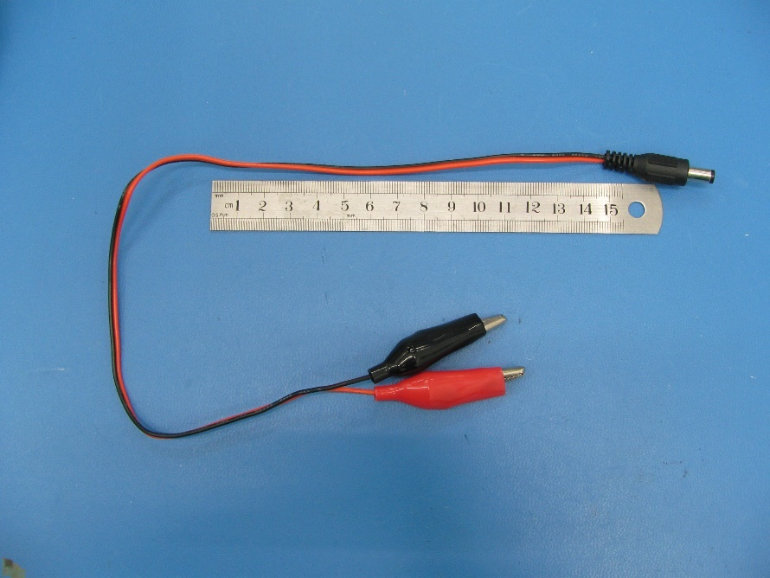
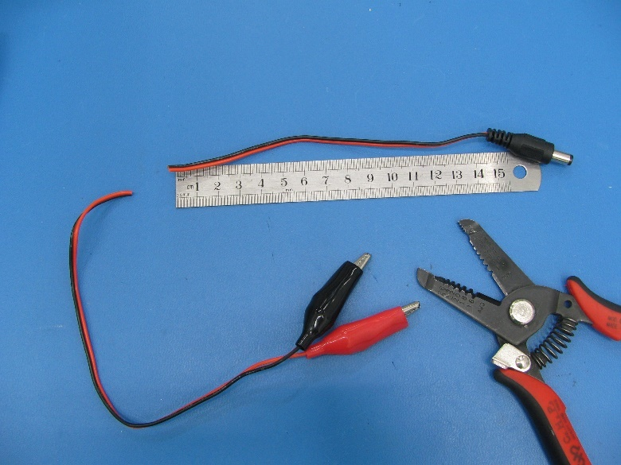
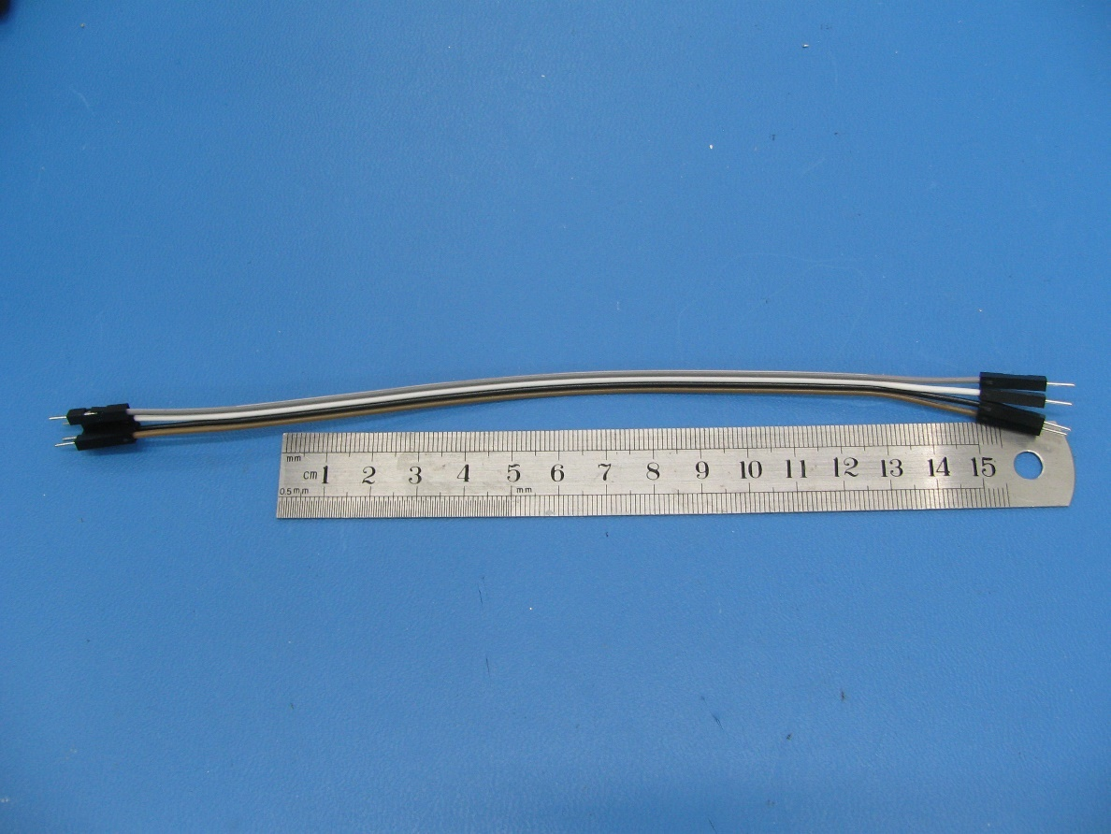
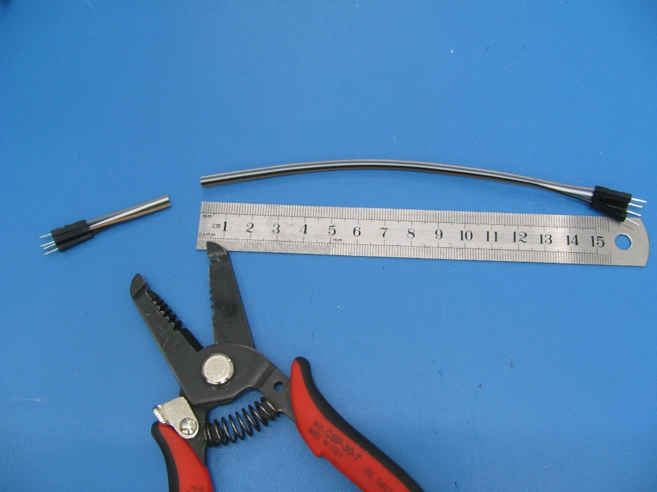
 | Step 1. Use the wirestrippers to cut the wire at 15cm away from the back of barrel plug. This will now be referred to as the 2-wire cable.
 | Step 2. Use the wirestrippers to cut the 4-wire cable at 15cm away from the Dupont connectors.

Slide 3
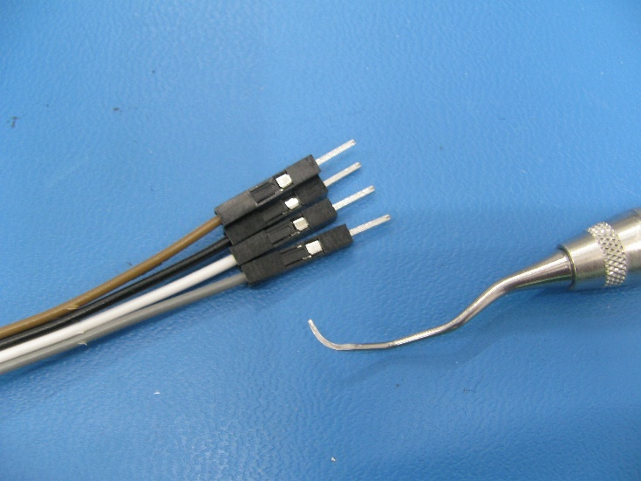
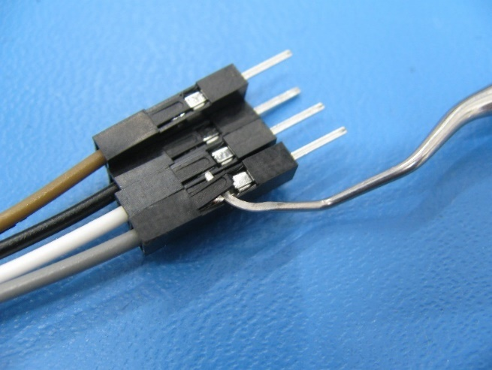
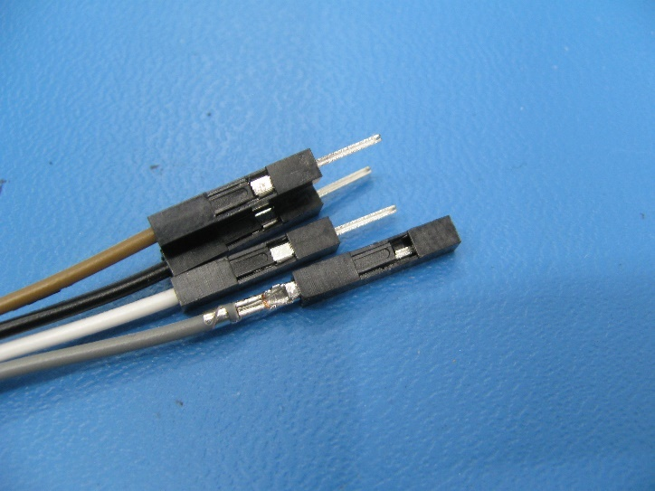
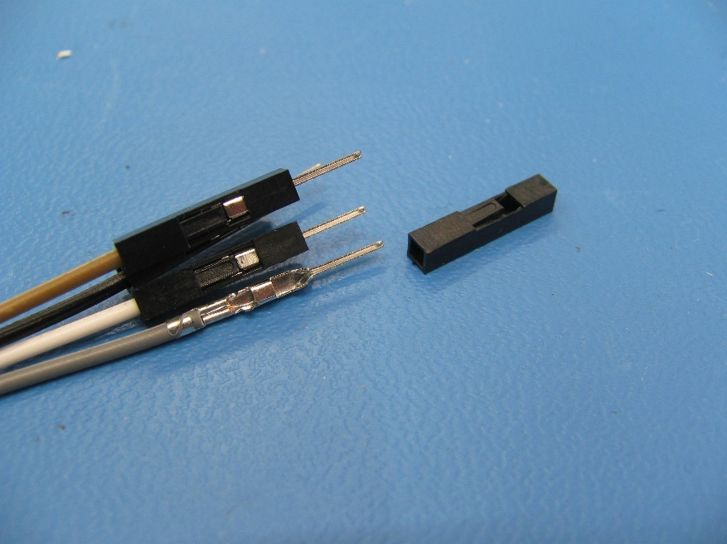
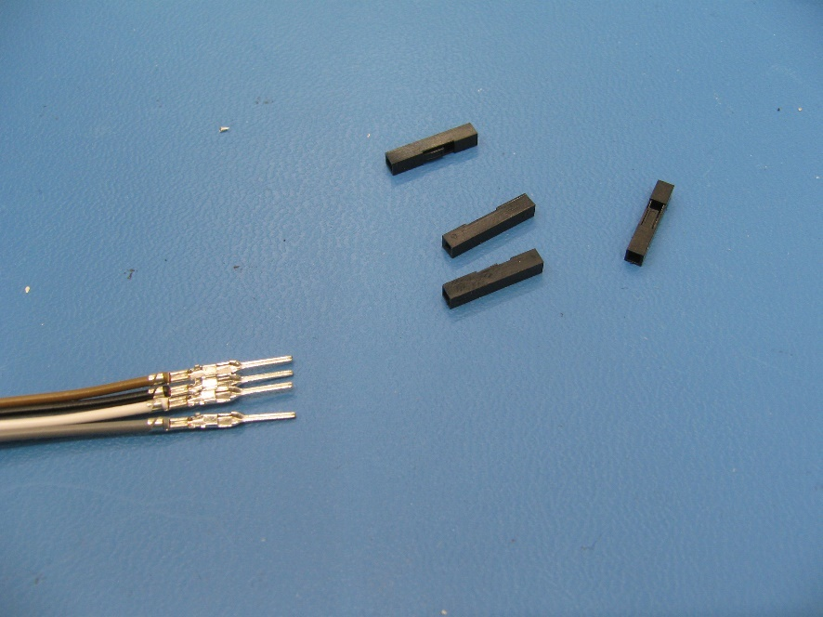
 | Step 3. Using the pick to lift up the locking tab on the Dupont connectors on the 4-wire cable.
 | Step 4. Remove all 4 Dupont connectors from the 4-wire cable.

Slide 4
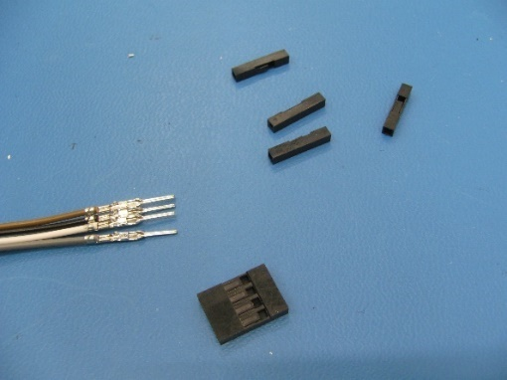
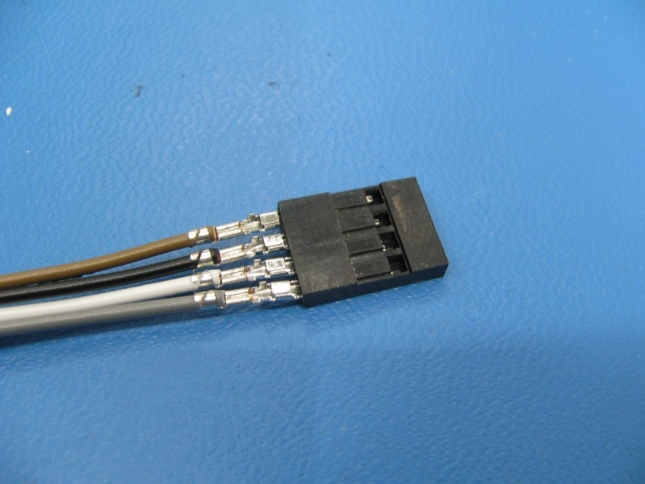
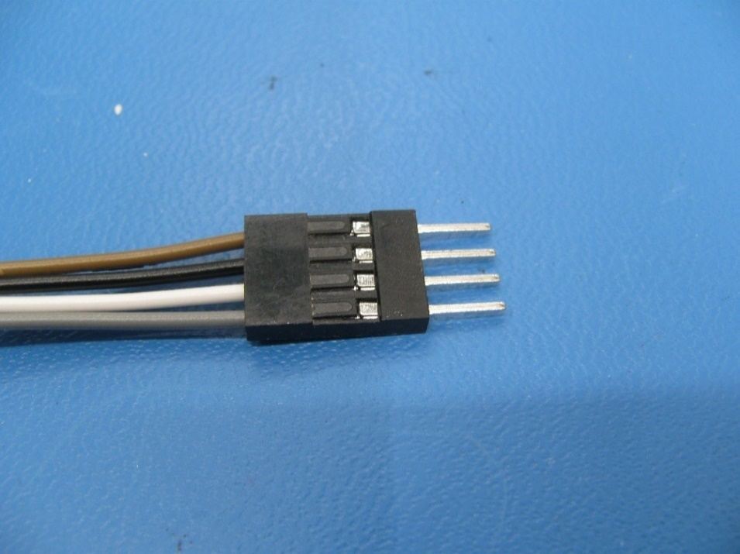
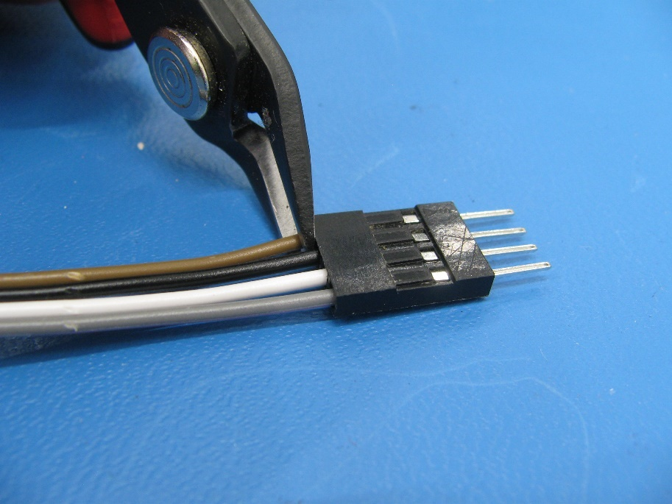
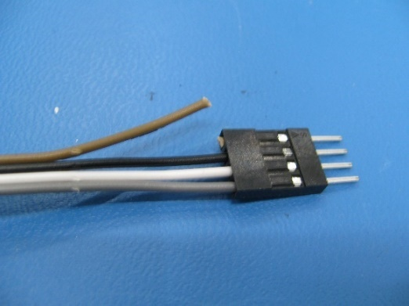
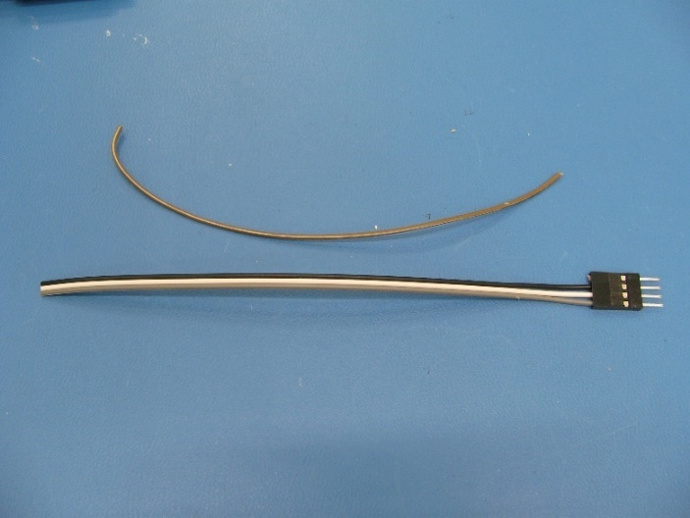
 | Step 5. Insert the 4 position Dupont connecter onto the 4 male pins of the 4-wire cable. *IMPORTANT* The Locking tabs on the Dupont connector must clip into position.
 | Step 6. Using the sidecutters cut the brown wire as close to the 4 position Dupont connecter as possible and strip the wire off the ribbon. This will now be referred to as the 3-wire cable.

Slide 5
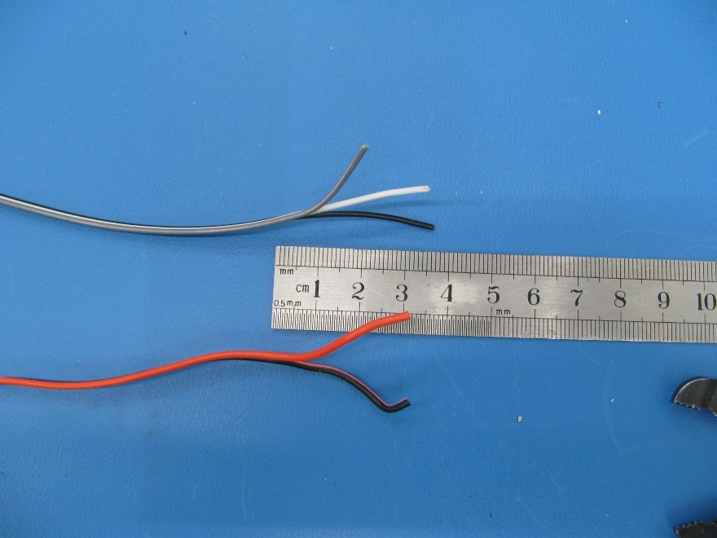
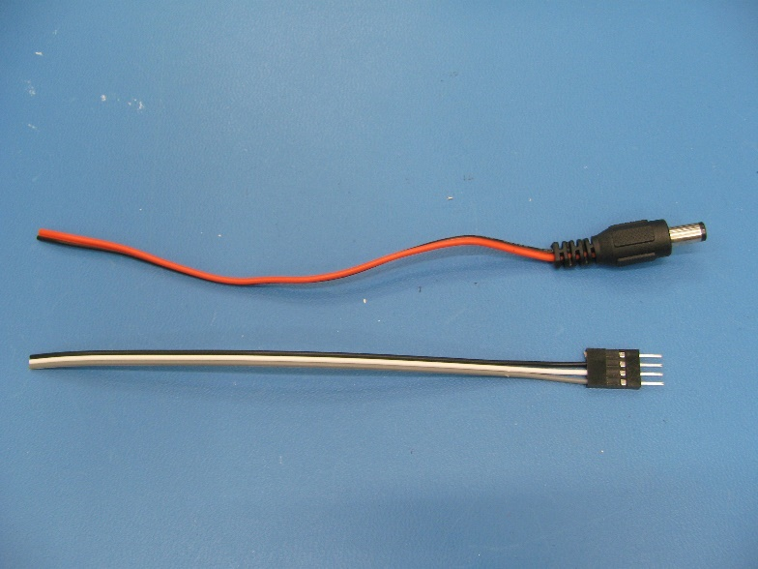
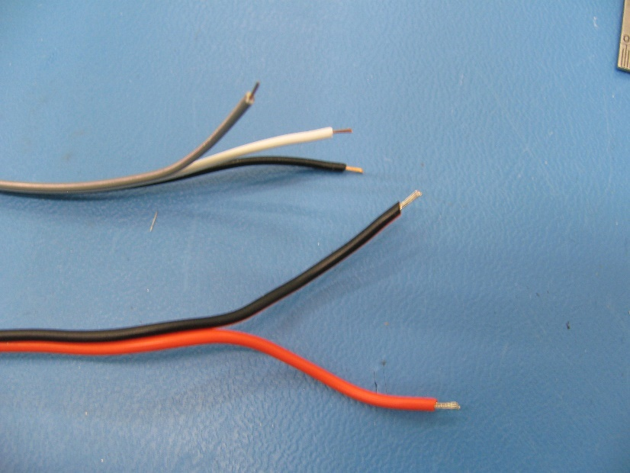
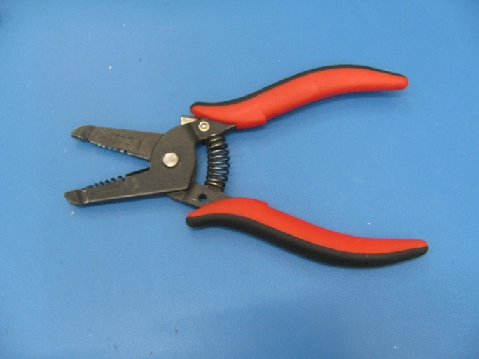
 | Step 7. Peel the ribbon wires back 3cm on the 2-wire and the 3-wire cables.
 | Step 8. Use the wirestrippers (22AWG setting) to strip off 3mm of insulation from all the wires on the 2-wire and 3-wire cables.

Slide 6
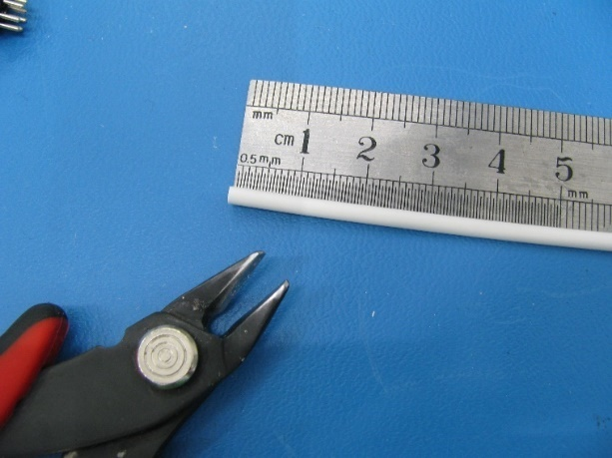
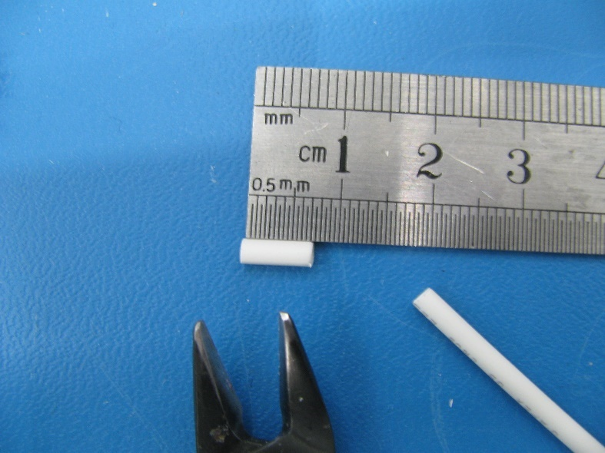
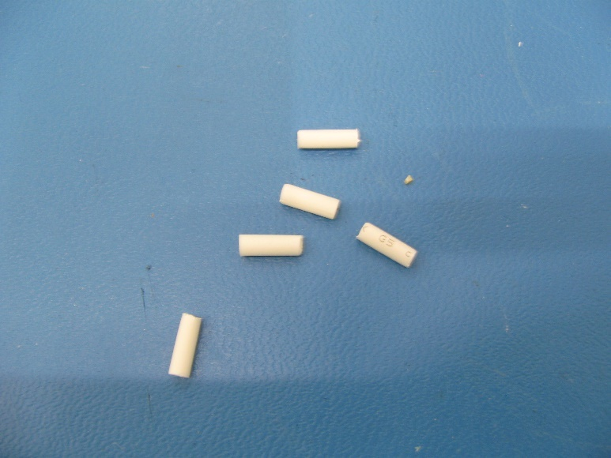
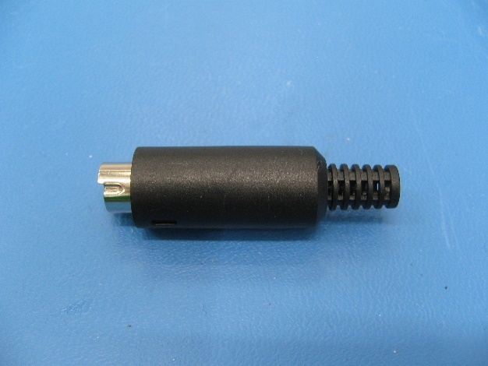
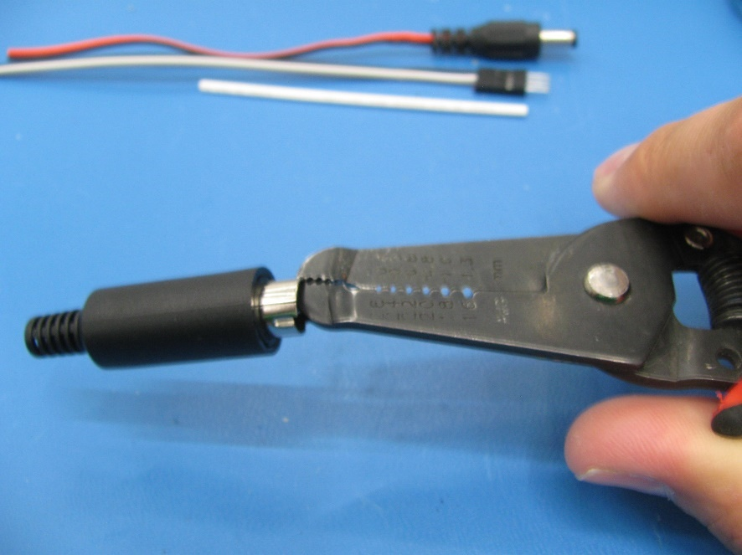
 | Step 9. Use the sidecutters to cut 5 x 7mm long pieces from the Heatshrink.
 | Step 10. Use the wirestrippers to remove the rubber shield from the DIN connector.

Slide 7
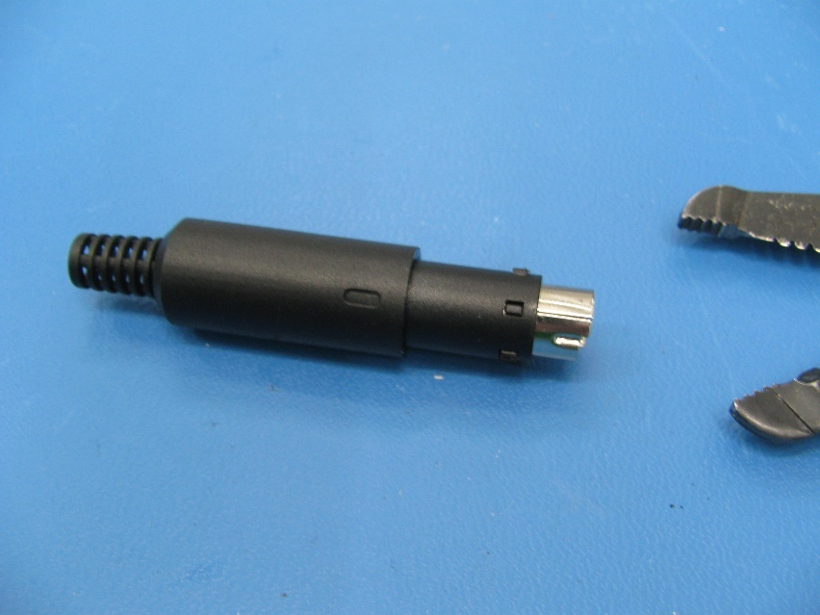
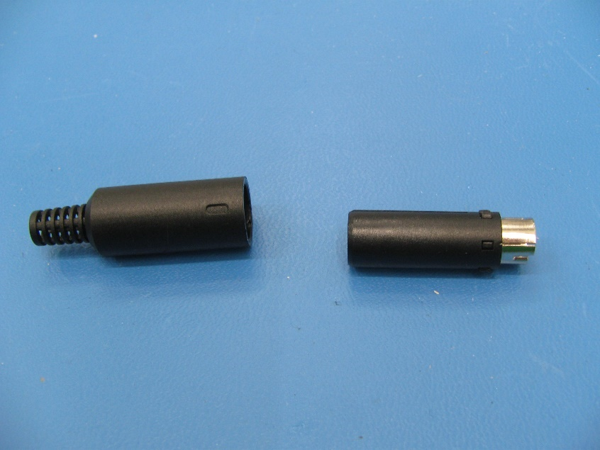
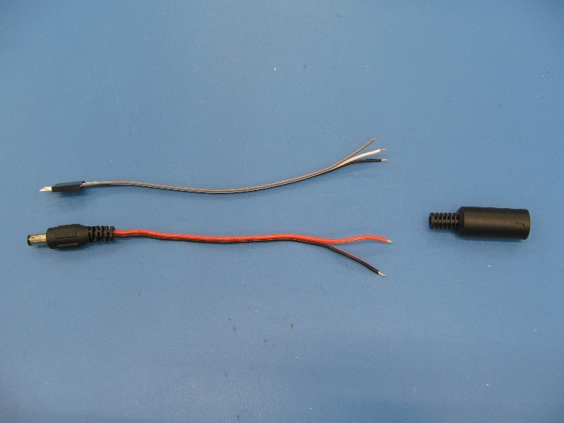
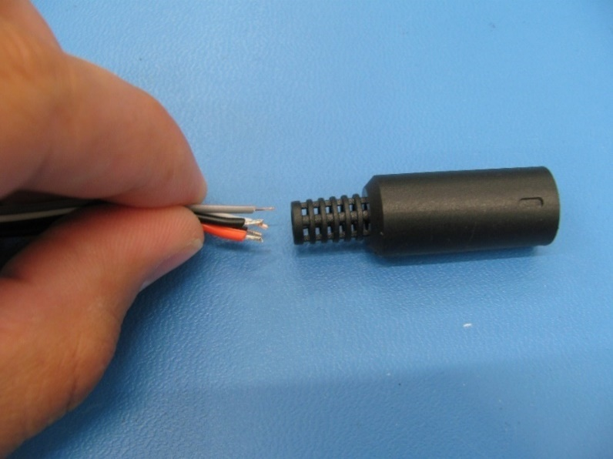
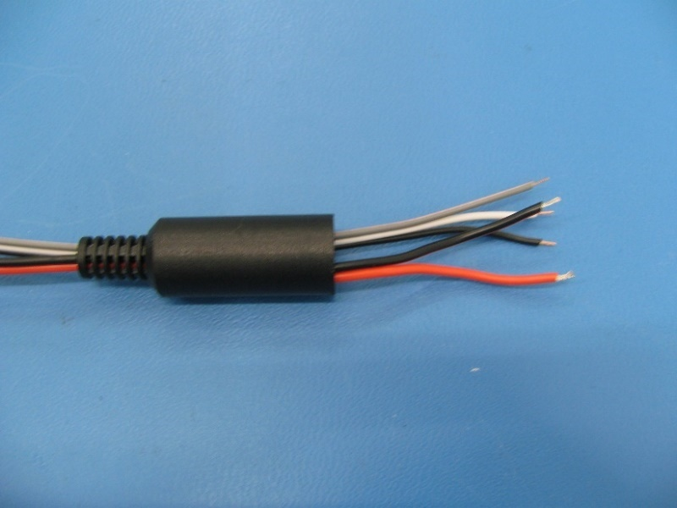
 | Step 11. Slide the rubber shield completely off the DIN connector.
 | Step 12. Take the 2-wire and 3-wire cables and push them through the small end of the rubber shield.

Slide 8

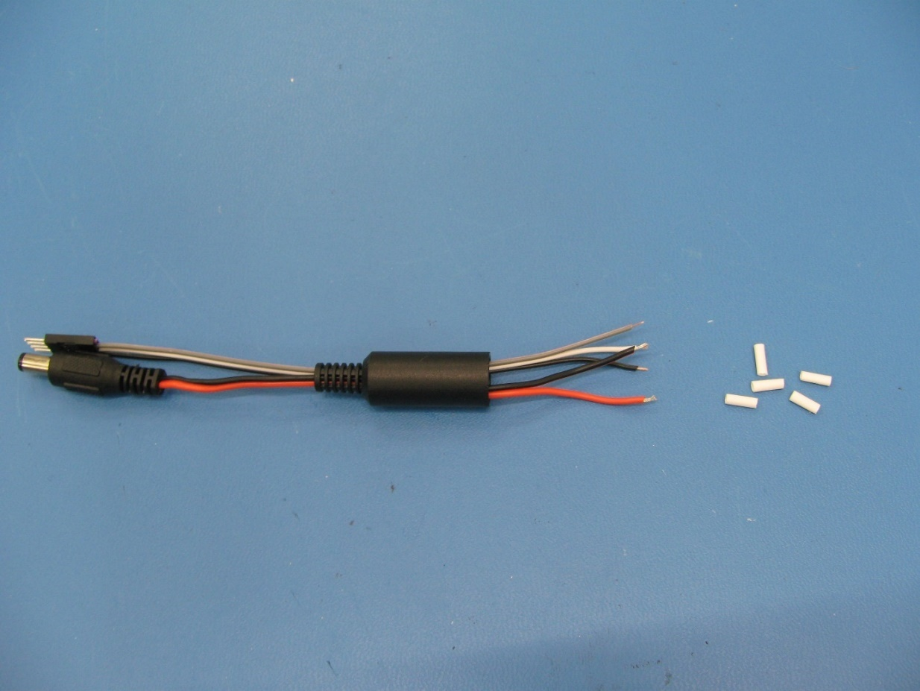
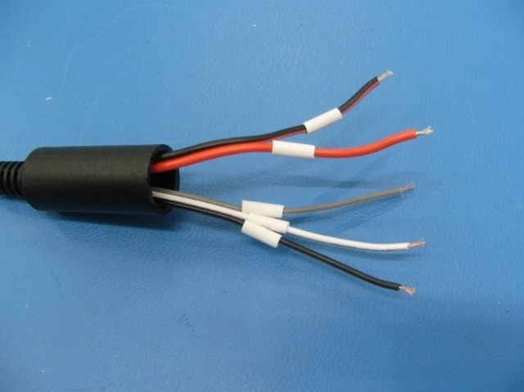
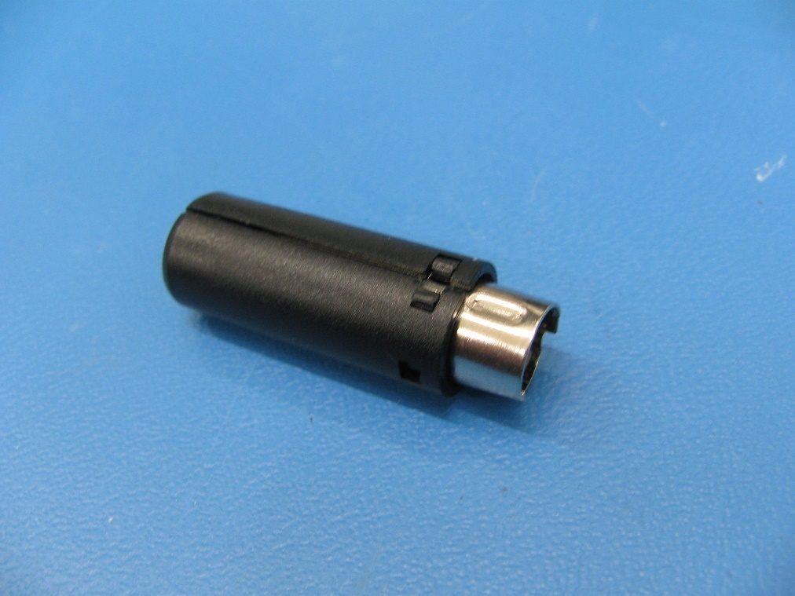
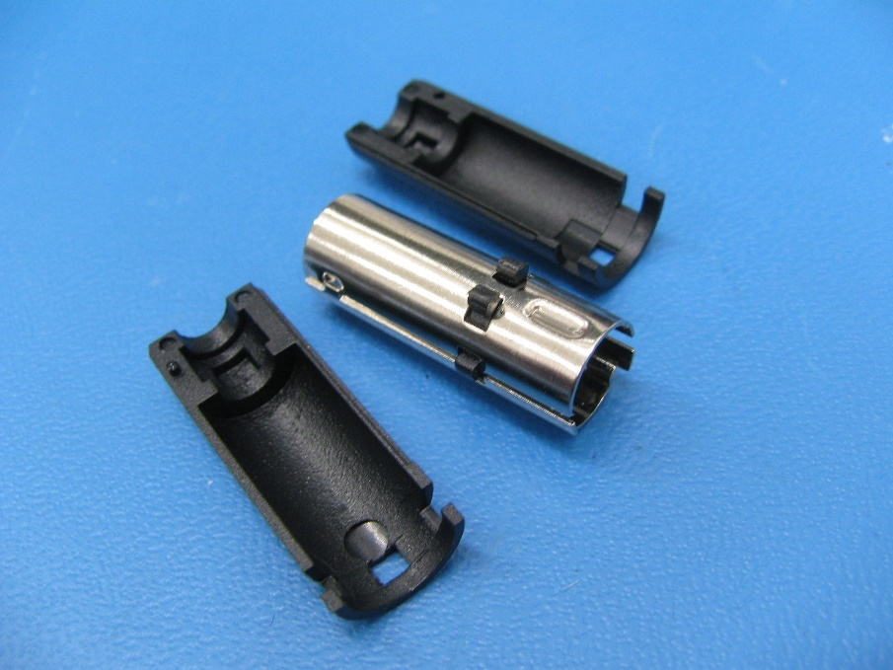
 | Step 13. Place the 5 x Heat Shrink pieces onto the 2-wire and 3-wire cable as shown.
 | Step 14. Separate the plastic shells from the DIN Connector.

Slide 9
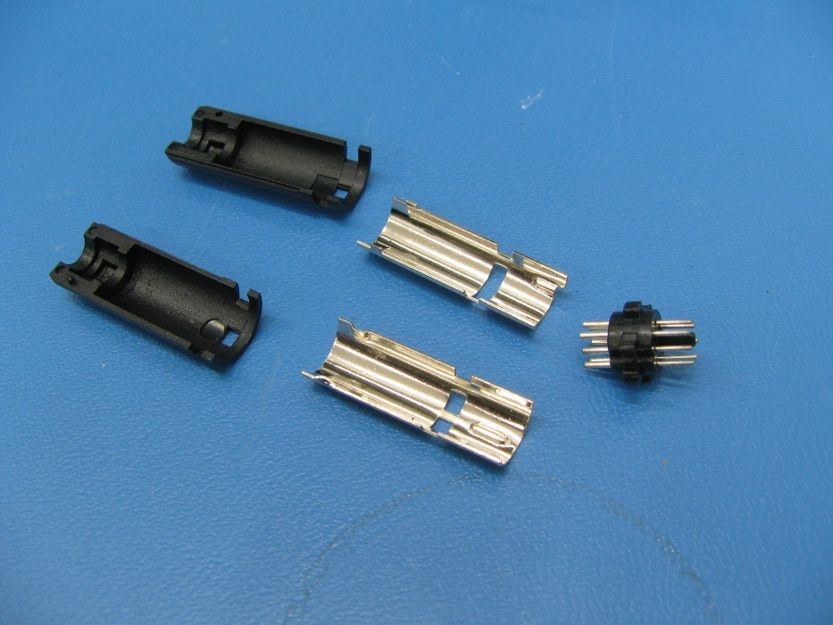
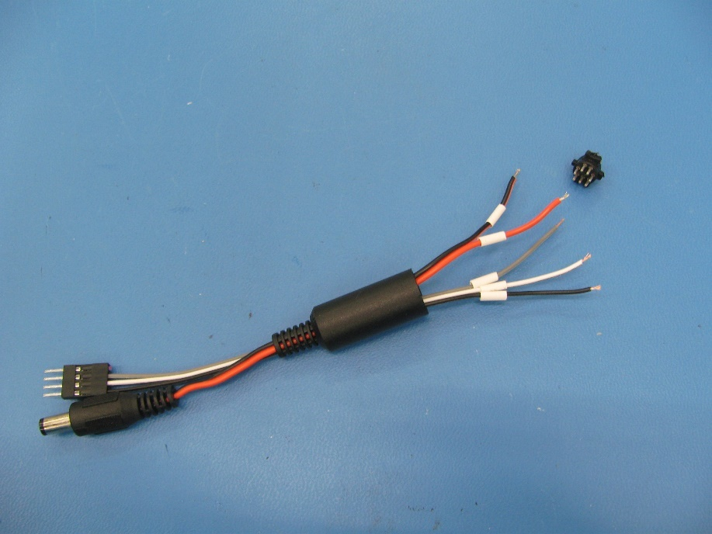
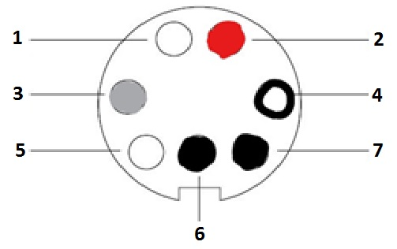
 | Step 15. Separate the metal shells from the DIN connector to release the pin block.
 | Wiring Diagram (Solder side of pin block): 1 – N/C 2 – Red Wire 3 – Grey Wire 4 – White Wire 5 – N/C 6 – Black Wire 7 – Black Wire
WIRING DIAGRAM

Slide 10
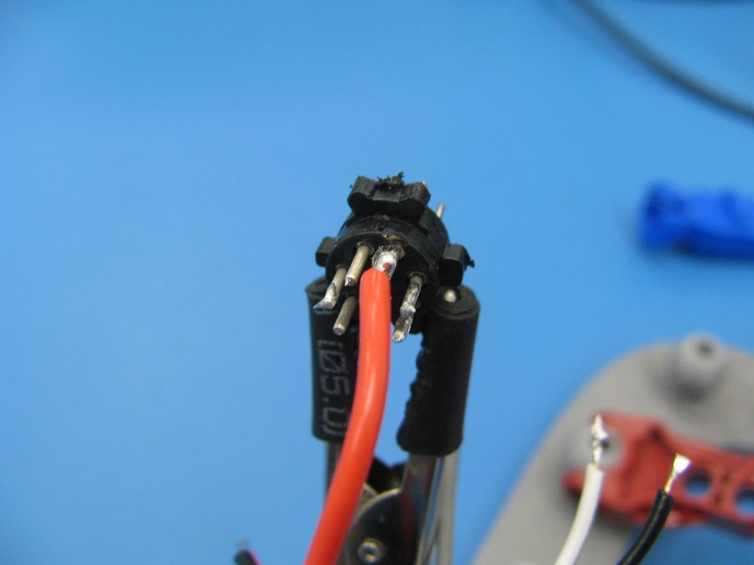
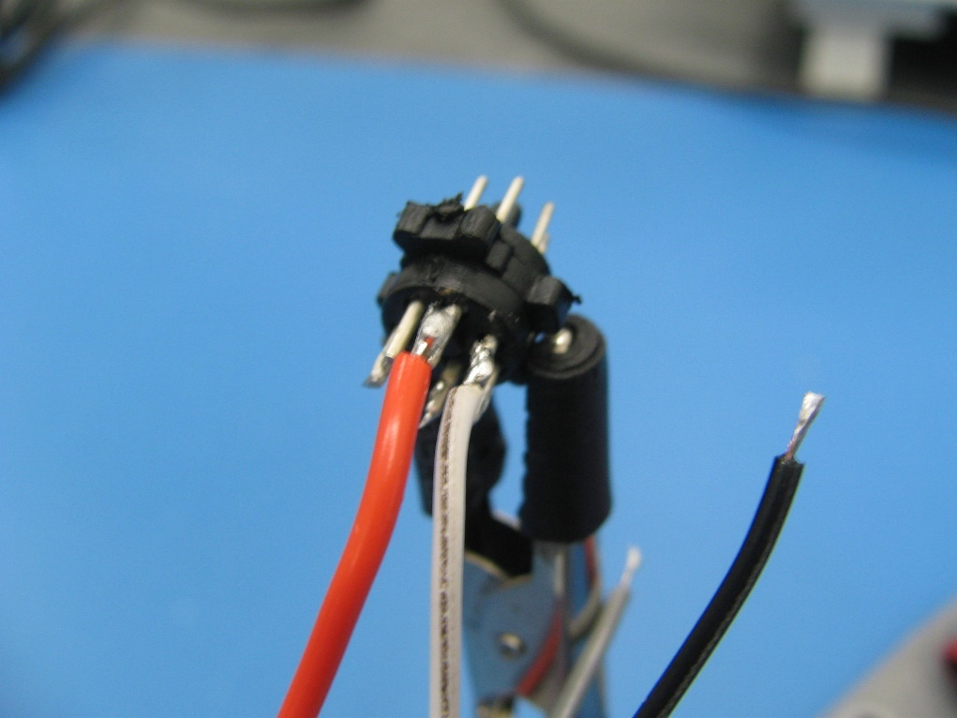
 | Step 16. Solder the 2-wire cable Red wire to position 2 on the DIN connector pin block.
 | Step 17. Solder the 3-wire cable White wire to position 4 on the DIN connector pin block.

Slide 11
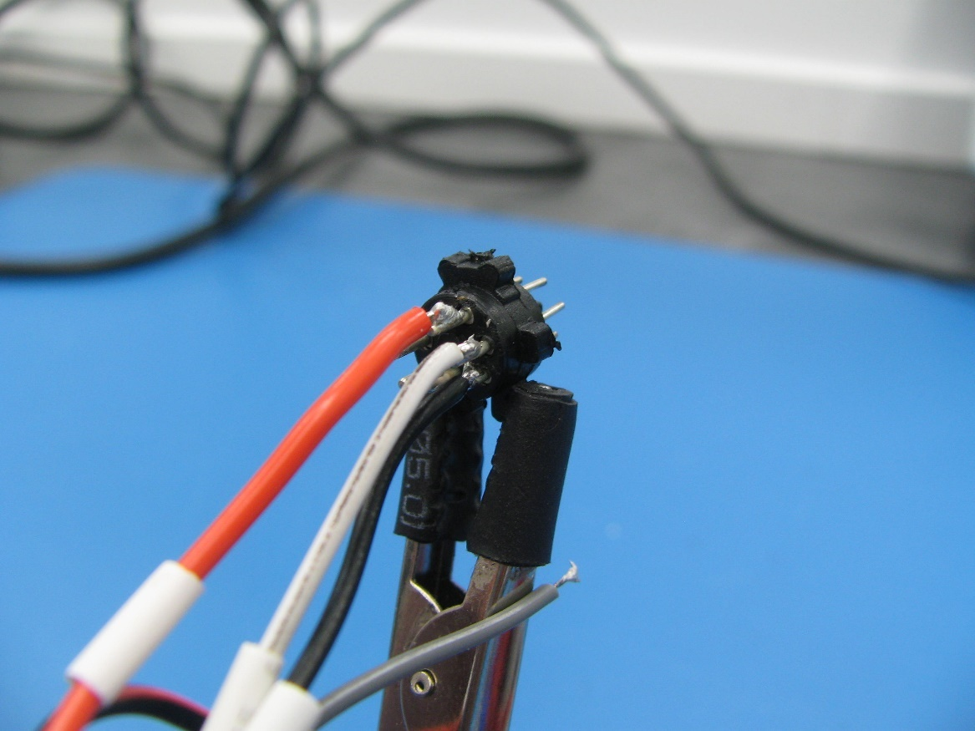
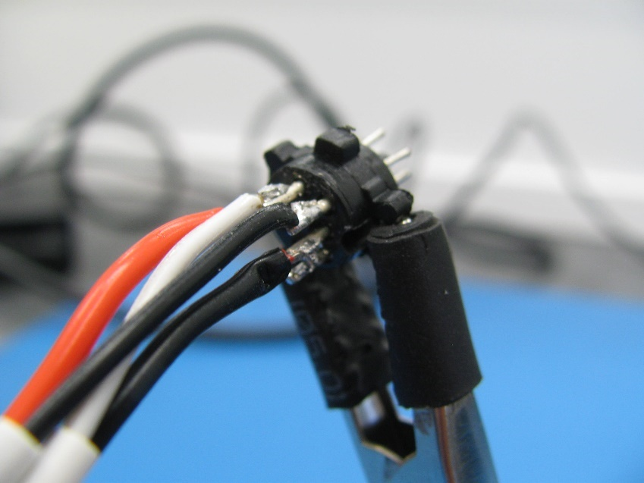
 | Step 18. Solder the 3-wire Black wire to position 7 on the DIN connector pin block.
 | Step 19. Solder the 2-wire Black wire to position 6 on the DIN connector pin block.

Slide 12
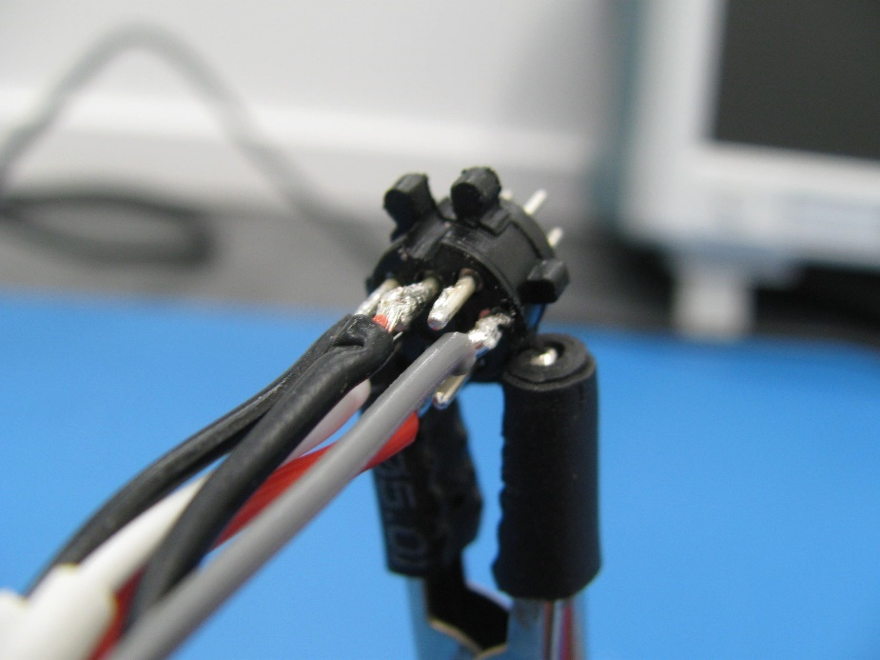
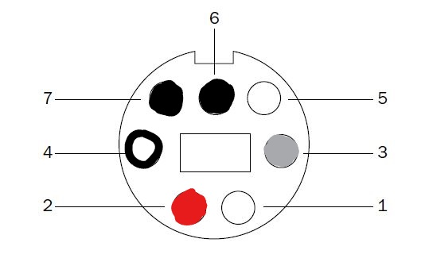
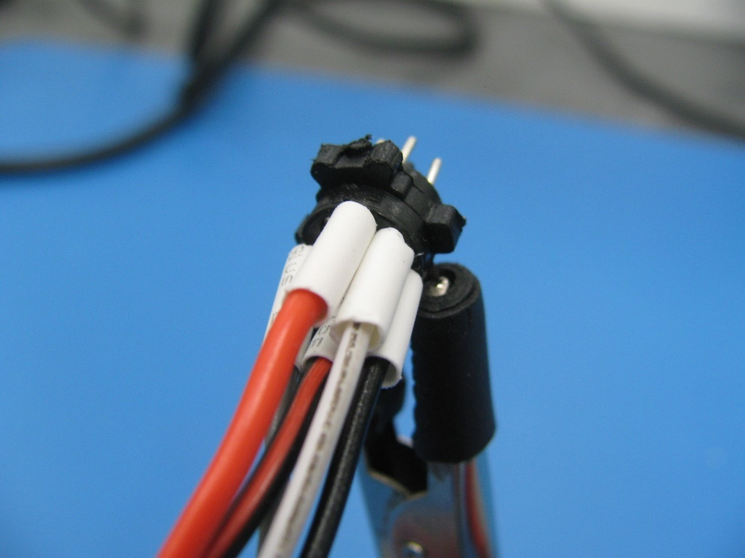
 | Step 20. Flip the pin block 180 degrees and solder the 3-wire Grey wire to position 3 on the DIN connector.
 | Step 21. Slide the 5 x Heatshrink pieces onto the solder connections.

Slide 13
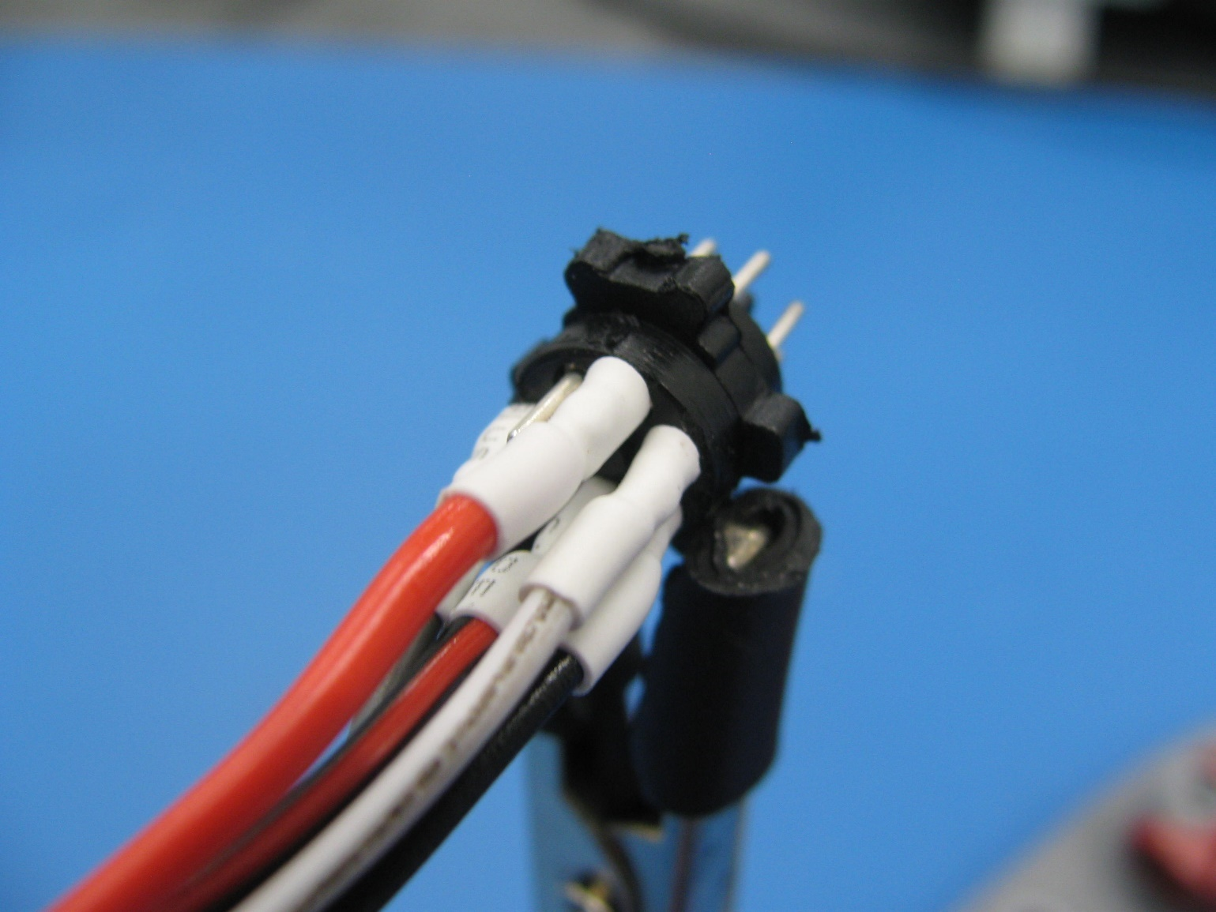
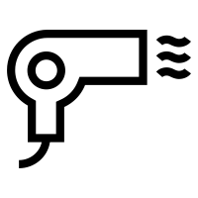
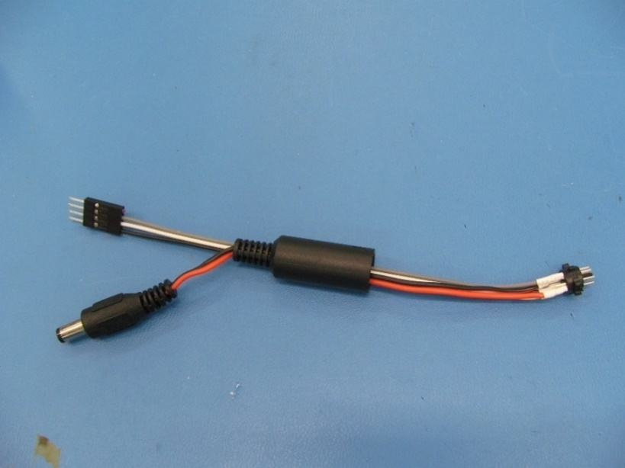
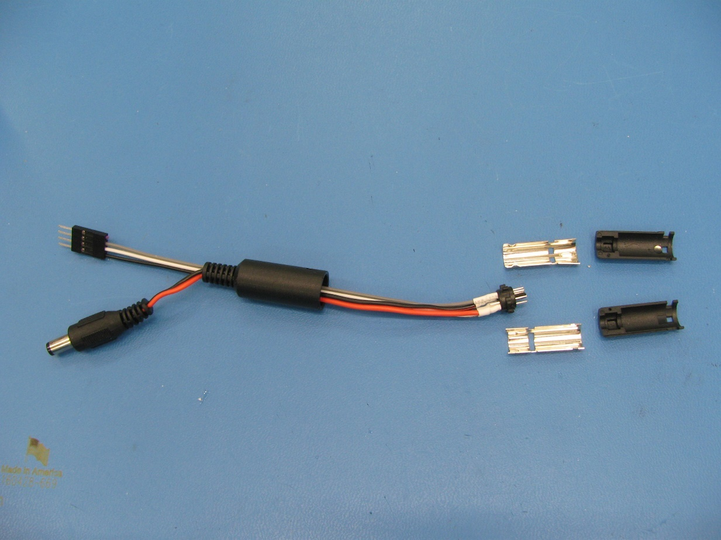
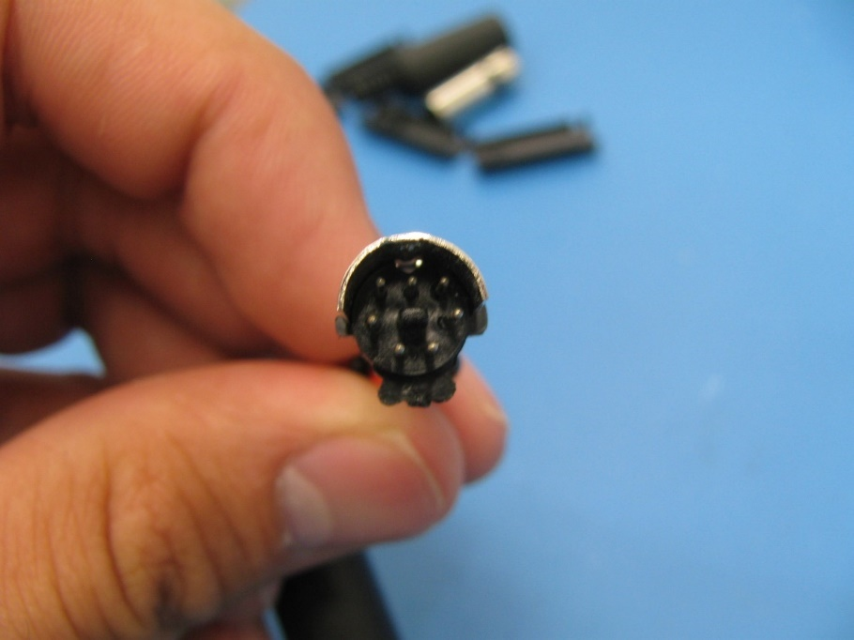
 | Step 22. Use a heat gun to shrink the 5 x Heat Shrink pieces.
 | Step 23. Attach the bottom DIN connector metal shell onto the pin block.

Slide 14
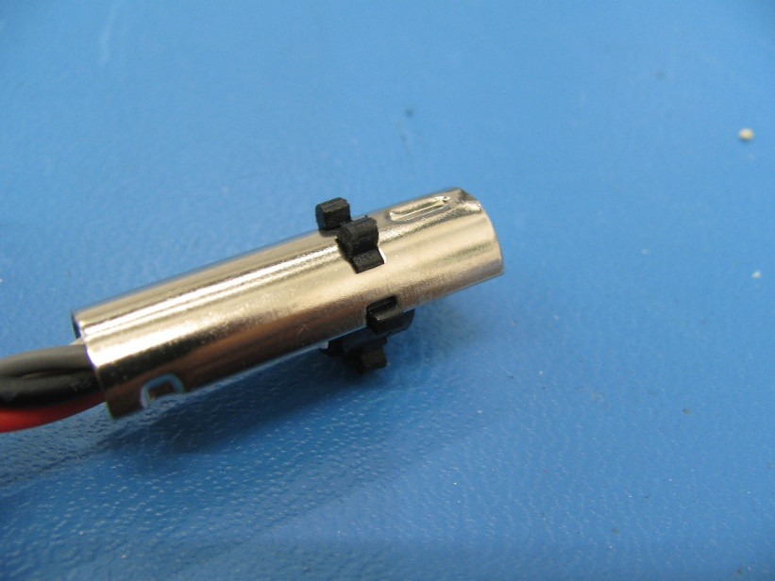





 | Step 24. Attach the top DIN connector metal shell onto the pin block.
 | Step 25. Attach the 2 x DIN connector plastic shells onto the metal shells.

Slide 15




 | Step 26. Push the Rubber shield from the wiring onto the DIN connector plastic shells until it locks in place.
 | E-46 is now complete!

